Slide 1


Hernando County
Housing & Supportive Services
HOME Investment Partnerships (HOME)
Tenant Based Rental Assistance (TBRA) Program

Slide 2
Introduction to HOME TBRA
The HOME Tenant-Based Rental Assistance (TBRA) program provides flexible rental assistance to help low‑income households secure and maintain affordable housing.
  Assistance may include rent, security deposits, and utility deposits
  TBRA is tenant‑based, allowing households to choose any qualifying unit
  Assistance typically lasts 12–24 months depending on program design

Slide 3
What is TBRA?
  Rental assistance for low‑income households
  Covers rent, security deposits, and utility deposits
  Families can select their own eligible unit
  Can be short‑ or long‑term based on policy
  Supports long‑term housing stability

Slide 4
Provider Responsibilities
Organizations administering TBRA must:
  Conduct outreach and accept applications
  Verify household income and eligibility
  Approve units and confirm rent reasonableness
  Complete required inspections and monitor corrections
  Execute leases and assistance contracts before move in
  Maintain complete files and provide ongoing monitoring
  Provide case management and supportive services as needed

Slide 5

Household Eligibility
To Qualify, households must:
  Have Income at or below 80% of Area Median Income (AMI)
  Meet any local preferences or priorities established for the program
  Provide all required documentation and verification materials

Slide 6

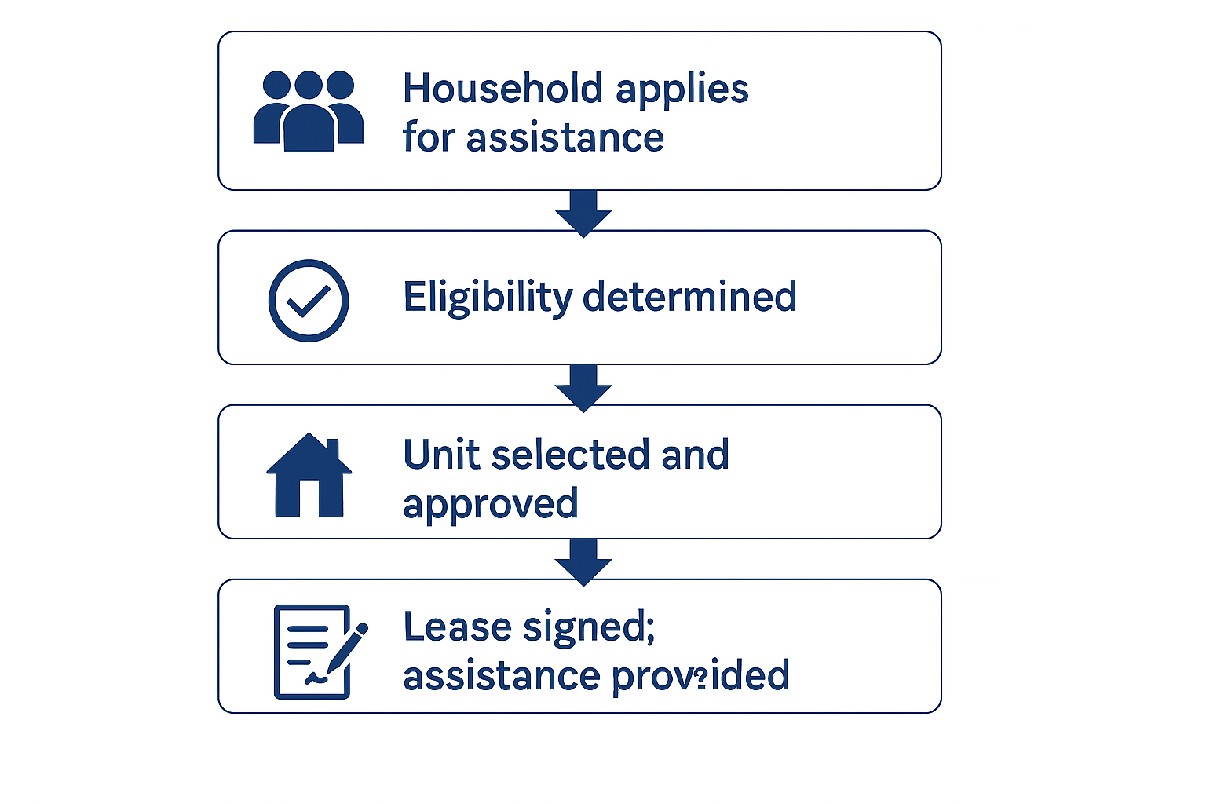



Unit Requirements
Before assistance begins, units must:
  Meet HOME rent limits
  Pass a rent reasonableness review
  Pass an HQS (or equivalent) inspection
  Use approved utility allowance schedules

Slide 7
Calculating Assistance
Providers must ensure assistance amounts follow HUD rules:
  Use HUD Part 5 income rules
  Apply correct utility allowances
  Ensure rent plus utilities meet HOME limits
  Set payment standards based on local policy
  Recalculate income annually

Slide 8
Housing Quality & Inspections
  Conduct initial inspection before household move-in
  Re-inspect annually or as required
  Record deficiencies and corrections
  Maintain inspection logs for monitoring

Slide 9

Leases & Contracts
  Lease must not include prohibited clauses
  The assistance contract must be executed before payments will begin
  Program rules must be clear regarding terms, termination, and rent issues
This Photo by Unknown Author is licensed under CC BY-SA

Slide 10
Payments & Financial Controls
  Make monthly payments directly to landlords
  Maintain clear reconciliation and tracking procedures
  Prevent overpayments through periodic reviews
  Adjust rent amounts based on program rules

Slide 11
Monitoring & Compliance
  Maintain complete, organized household files
  Monitor landlord compliance
  Update internal policies as regulations change
  Update staff regularly on internal policies and TBRA requirements

Slide 12
Strong Application Requirements
Strong TBRA applicants can demonstrate:
  Defined program structure and staffing plan
  A clear and detailed program design
  Solid internal controls and financial management
  Provide case management and supportive services as needed
  Partnerships supporting outreach and services
  Sample forms showing readiness to operate

Slide 13
Common Application Pitfalls
To avoid delays or denial, applicants should not:
  Provide vague descriptions of program operations
  Present unclear or insufficient staffing capacity
  Submit incomplete documentation or missing attachments
  Show limited or no compliance experience
  Provide unrealistic timelines or deliverables

Slide 14
Closing Summary
TBRA expands access to affordable housing through flexible, well‑managed rental assistance.
  Supports community housing goals
  Helps households achieve stability
  Requires strong documentation and compliance
  Works best with clear policies and consistent processes

Slide 15
Contact us:
Hernando County Housing & Supportive Services
Phone: (352) 540‑4338
Email: HousingandSupportiveServices@HernandoCounty.us

Slide 16

Questions

